Slide 1
IEEE PES Day 2024
1

Slide 2
Contents
2
PES & PES Day overview
PES Day 2024 Overview
PES Day 2024 Theme
Ambassadors Benefits, Categories, Responsibilities
PES Day Event Resources
Contact

Slide 3
IEEE PES & PES Day overview
3
Why... PES Day?
On April 22, 2008, the Power Engineering Society changed its name to the Power & Energy Society to focus on helping environment and society.
The former IEEE PES President Wanda Reder made this announcement at the IEEE PES Transmission and Distribution Conference in Chicago, Illinois.
PES Day goal is to engage the PES volunteers with PES history and “5” PES pillars of the “More Power to the Future” vision:
Advancing global participation.
Educating the Future Workforce.
Industry Activity Trends.
Standards Leadership.
Participating in Regulatory Initiatives.

Slide 4
PES DAY 2024 Overview
4
The theme "Empowering Electric Mobility Innovation" is selected for PES Day 2024 to spotlight the transformative potential of electric mobility in shaping a sustainable and resilient future. This focus emphasizes the crucial role of electric vehicles (EVs) and their seamless integration into the broader energy landscape.
Key Objectives of the Theme:
1. Advancing Sustainable Transportation: Highlighting the pivotal role of electric mobility in reducing greenhouse gas emissions, improving air quality, and promoting sustainable transportation alternatives.
2. Infrastructure Evolution: Showcasing the ongoing developments in charging infrastructure, smart grids, and energy storage systems to support the widespread adoption of electric vehicles.
3. Innovation in Vehicle Technology: Celebrating advancements in electric vehicle technology, including improvements in battery efficiency, range, and the integration of smart features..

Slide 5
The 7th PES DAY celebrations would focus on “Empowering Electric Mobility Innovation”
5

Slide 6
Ambassadors Benefits
8
Leadership opportunity
Network and build Global Connections
Scholarship opportunities
IEEE PES Day 2024 Ambassador Certificate
Mentoring opportunities from experienced professionals
Access to exclusive events and resources
Opportunities to collaborate with other ambassadors on projects & initiatives

Slide 7
Ambassadors Categories
8
IEEE:
IEEE Section Ambassadors
IEEE Student Branch Ambassadors
IEEE YP Ambassadors
IEEE WIE Ambassadors
PES:
IEEE PES Chapter Ambassadors
IEEE WIP Ambassadors
IEEE PES Student Branch Chapter Ambassadors
IEEE PES YP Ambassadors

Slide 8
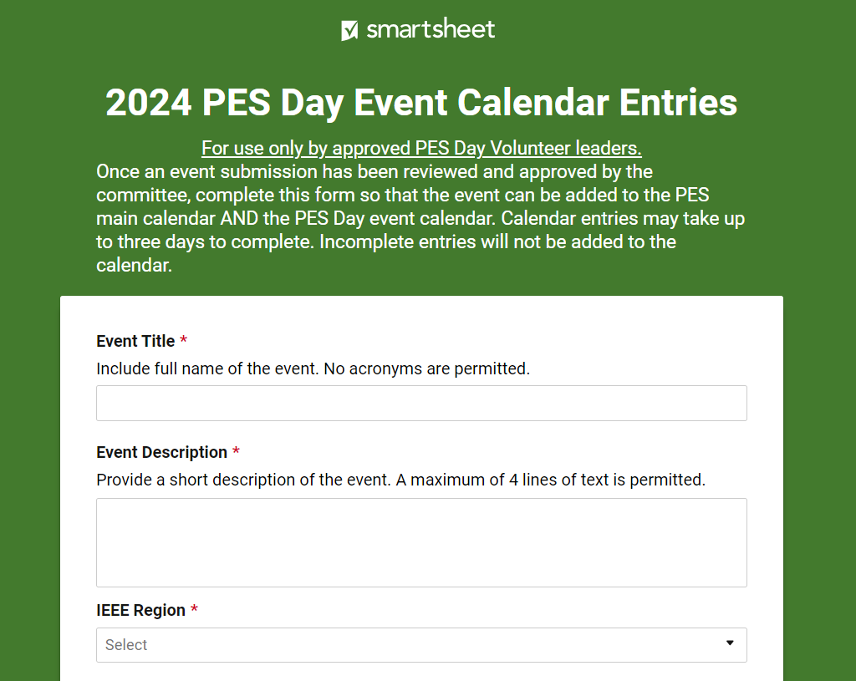
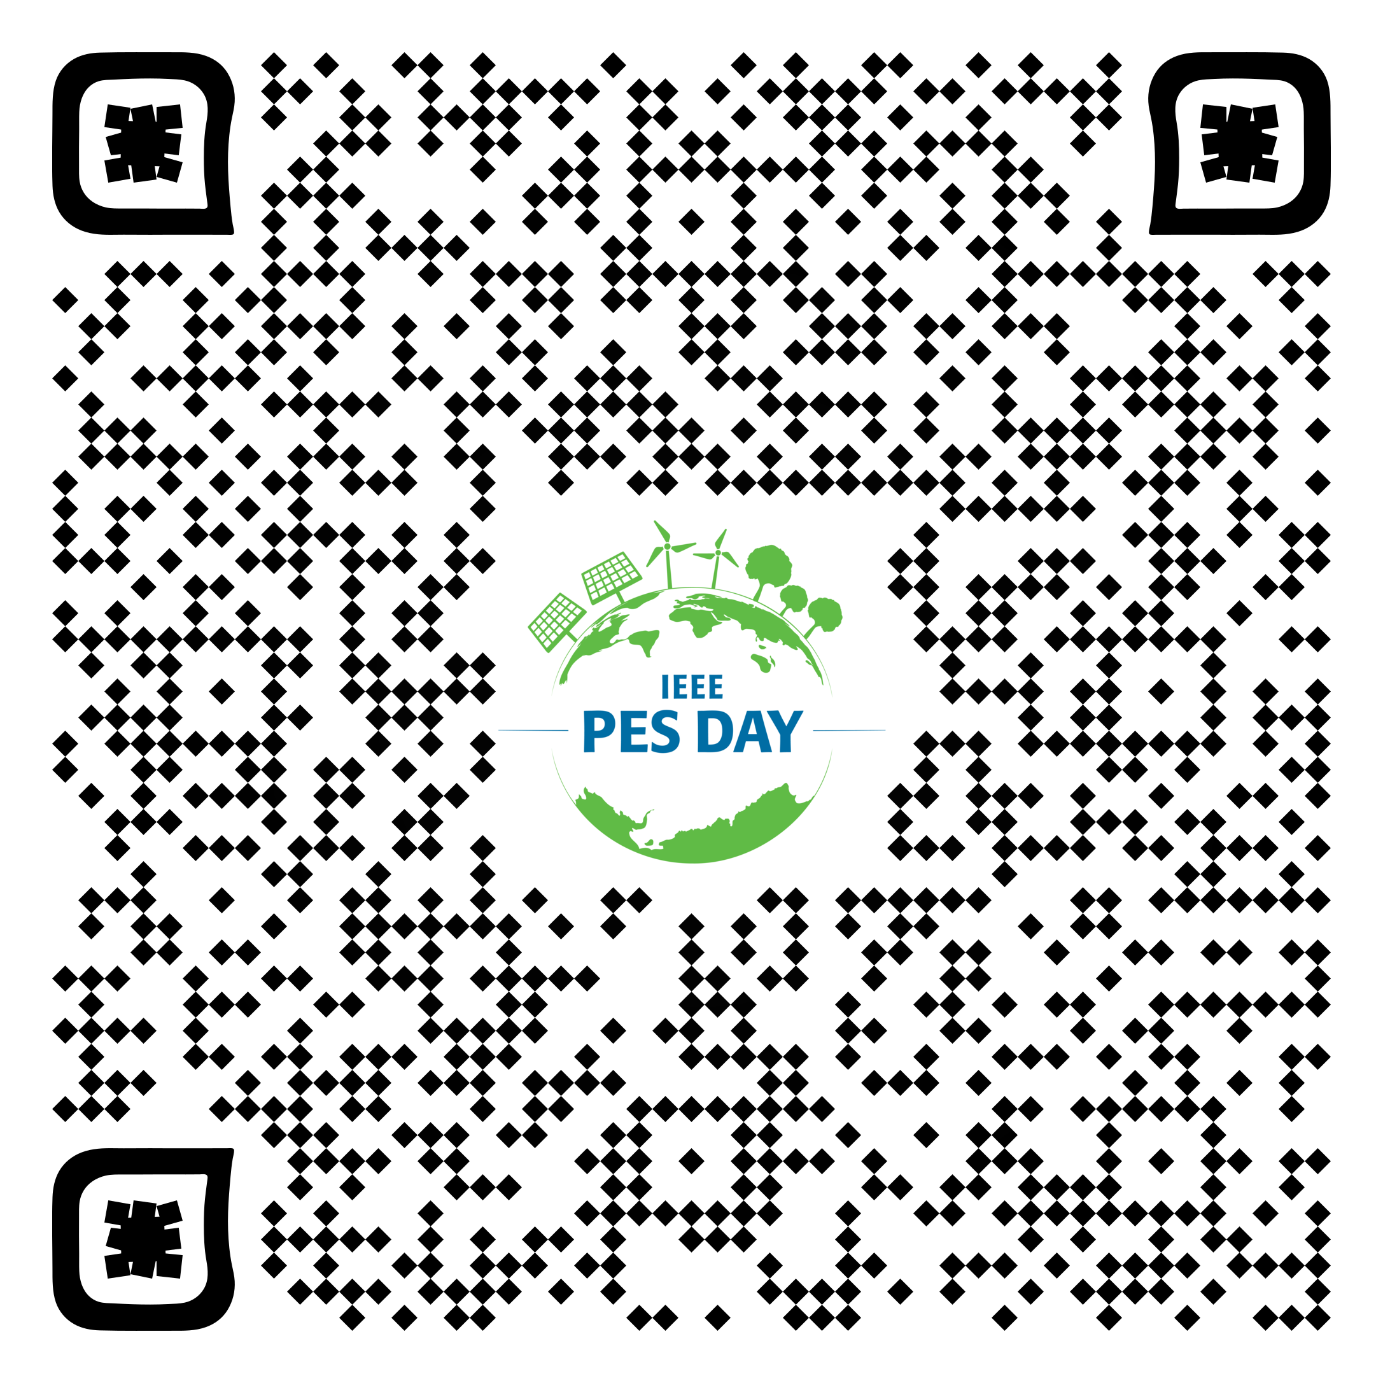
Ambassador Responsibilities
9
Organize at least one event focusing on the PES Day theme (Empowering Electric Mobility Innovation) and Report your event through -

Slide 9
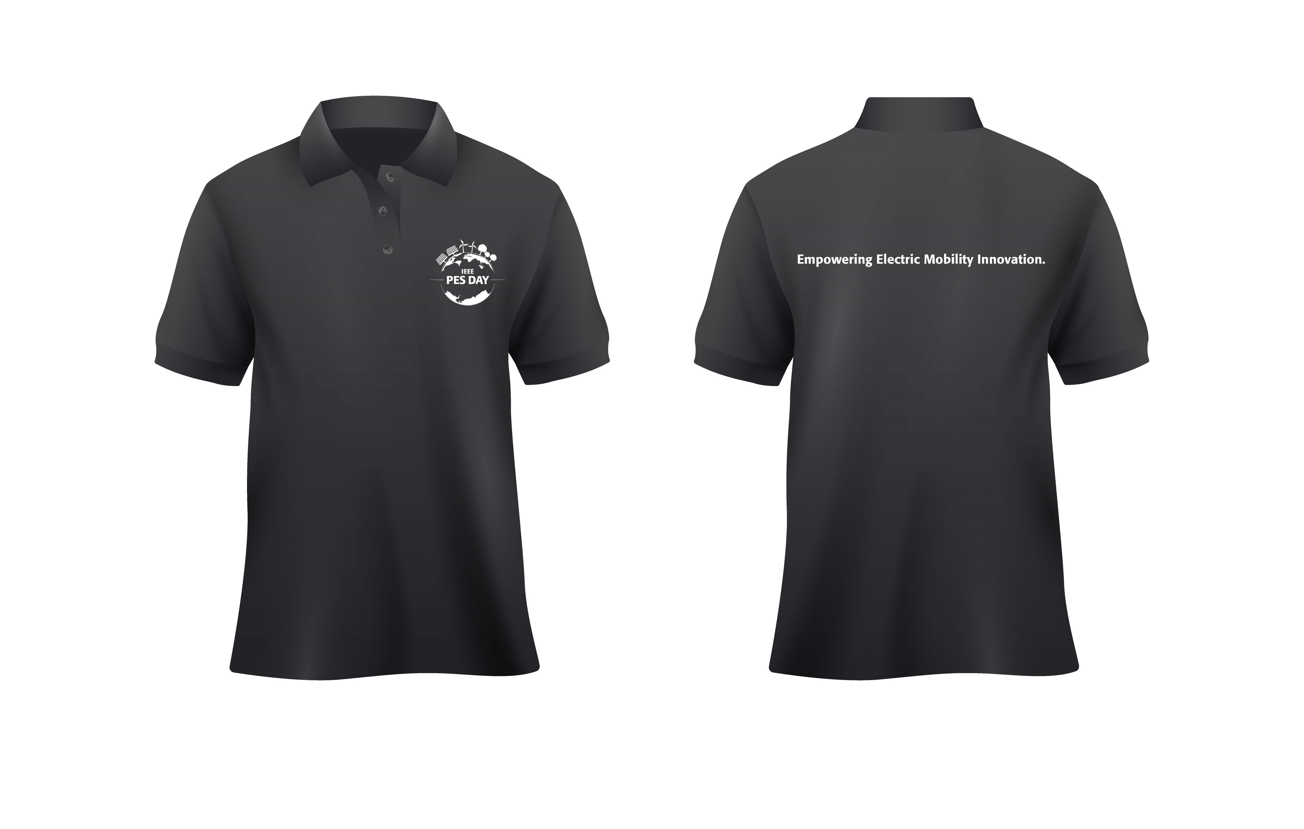
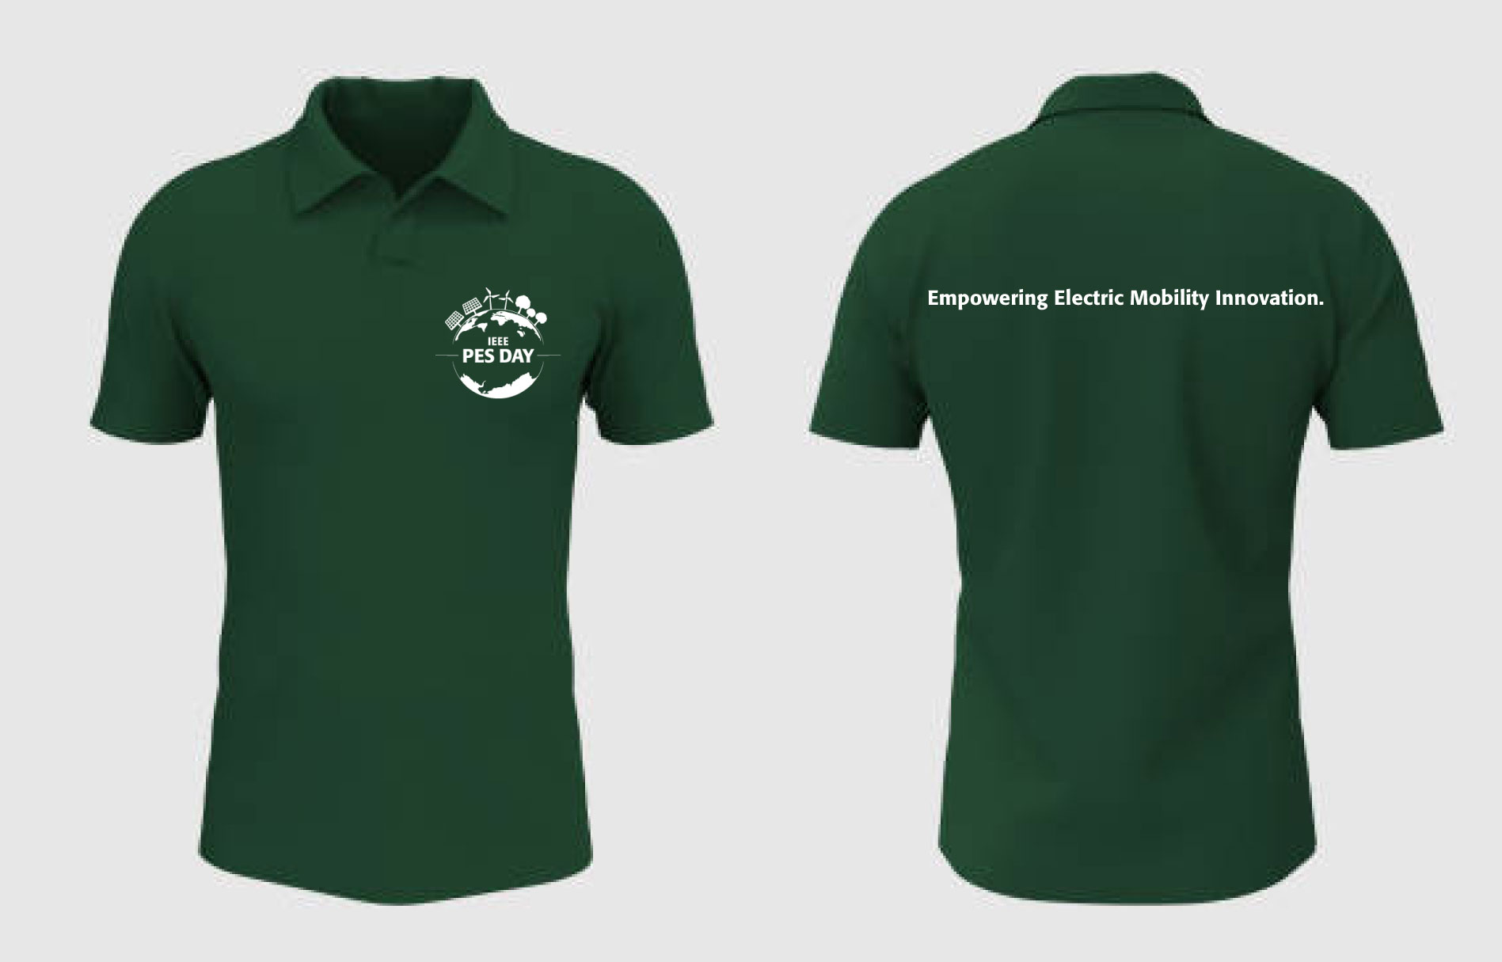
What we can offer?
14
All promotional materials available under Resources- Promotional Materials (that includes the Logo, T-Shirt Designs , Flyers etc.)

Slide 10
How PES DAY Supports PES Membership Resources?
15

Slide 11
Contact & Follow Us
15
ieeepesday@gmail.com
www.youtube.com/@ieeepesday
www.facebook.com/pesday
www.linkedin.com/company/pesday
twitter.com/ieeepesday
www.instagram.com/ieeepesday/

Slide 12
39
Other IEEE Societies
22
IEEE
420,000+
members
Founded 1963
IEEE PES
+37,000
members
+230
Chapters Across 10 Global Regions
PES Governing Board includes Vice Presidents which oversee
New Initiatives & Outreach
Meetings
Technical Activities
Publications
Technical Committees
Standing
Committees
Membership & Image
Education
Standards Developing Technical Committees
Coordinating Committees

Slide 13
PES Day 2024
23

